Slide 1












Hidden Universes of Information
on the Internet
Day #1 & Day #2
abyznewslinks.com
Revision 07/2025
Note: If you send me an email, put “internet training” in the e-mail's subject
Copyright © Russ Haynal

Slide 2
Course Outline
specific_page.html
Introduction to Internet Architecture
“Persona” issues
Search: Search Engines
Search: “User pages”
Search: Specialized Tools
Source Evaluation
Review / Summary
Online Web page = http://navigators.com/opensource.html

Slide 3

Disclaimer
This session illustrates a wide variety of search tools, techniques and research methods
Consult your organization’s policies to verify if these methods are approved for your types of Internet connections (including visits to navigators.com)

Slide 4
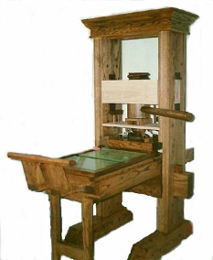
Internet Definition
stats.html
“A large collection of inter-connected networks and computers”
“A new fundamental form of communication that will absorb other communication channels”
Internet represents a
once per thousand year event
Last such event = Gutenberg printing press
Are You Literate in Today’s Online World?

Slide 5
Number of Hosts in each Domain
stats.html
Top Level Domains
jp | 79,002,746
de | 48,087,619
br | 46,023,691
it | 28,538,734
fr | 23,529,249
cn | 20,196,732
mx | 19,298,175
au | 16,792,160
ar | 14,737,149
nl | 13,188.872
ru | 13,183,783
pl | 12,897,921
ca | 10,242,678
in | 8,337,038
tr | 6,998,966
co | 6,851,655
tw | 6,811,801
za | 6,005,425
uk | 5,740,402
be | 5,520,698
se | 5,473,537
ch | 5,230,015
eg | 5,044,567
es | 4,798,915
fi | 4,548,069
th | 3,879,942
no | 3,798,249
 | pt,at,cl,cz
 | hu,dk,gr,nz
 | il,ro,ua,sg
us | 2,025,370
net | 386,970,568
com | 169,975,462
edu | 11,424,990
gov | 2,276,632
org | 2,161,611
mil | 1,443,379
Source: www.isc.org

Slide 6
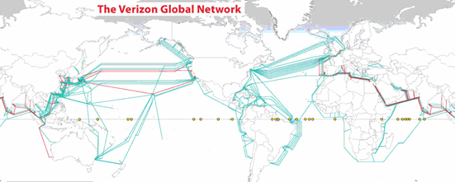
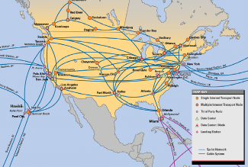
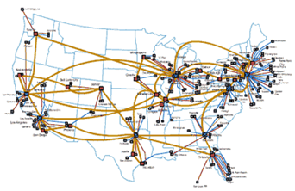
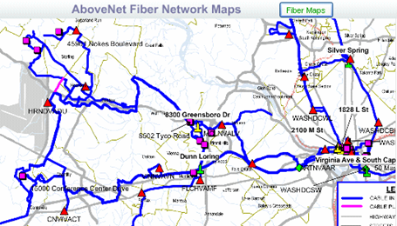
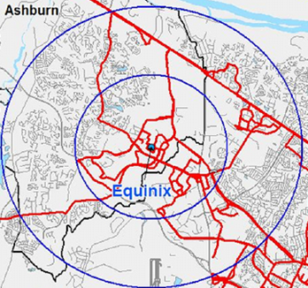
Example Network Maps
country_specific_infrastructure.htmll
Sprint
AT&T
Verizon
Ashburn
Washington DC
“The Bullseye of America’s Internet”

Slide 7






Many People Can Observe Your Internet Usage
traceroute.html
Network traffic flows through multiple Internet providers
Routers direct packets of traffic along the “preferred” path
backbone
ISP- A
backbone
ISP- B
large
organization
Private Peering
webhosting
cloud
VPN
regional
ISP #2
regional
ISP #1
Exchange Point
Server
Backbone ISP
Regional ISP
Client(PC)
Enterprise LAN
Notes:
8
8

Slide 8
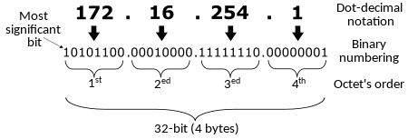
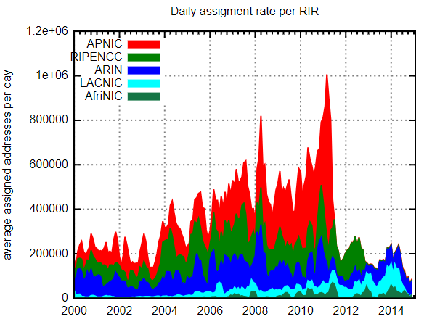
Internet Protocol Address (IPv4)
traceroute.html
Has 32 bits of information (a binary sequence of 32 zeroes and ones)
Expressed as a set of 4 numbers, each number has a range of 0-255
Total number of possible IPv4 Numbers: 4,294,967,296 (2³²)
1 million IPv4 numbers per day were being allocated, until depletions began in 2011

Slide 9
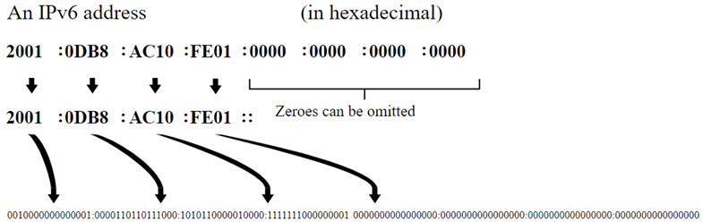
Internet Protocol Address (IPv6)
traceroute.html
Has 128 bits of information (a binary sequence of 128 zeroes and ones)
Expressed as 8 groups of 4 hexadecimal digits (0-9, ABCDEF)
340,282,366,920,938,463,463,374,607,431,768,211,456 (2¹²⁸) unique IPv6 addresses
3,911,873,538,269,506,102 addresses per square meter of the Earth's surface​
4,500,000,000,000,000 addresses for every star in the entire universe
IPv6 supports prioritization of traffic and simplifies route addressing

Slide 10
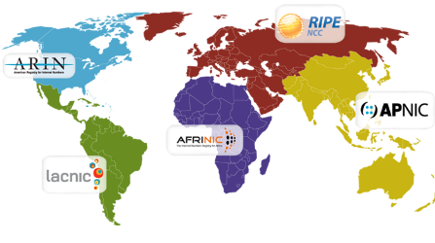
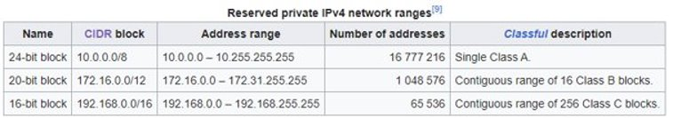
IP address Allocation
whois.html
- Every Internet connection has a unique IP address
- IP addresses are initially allocated through a hierarchy, and can “migrate” via multi-national companies, mergers, acquisitions
IANA Regional Internet Registry Local Internet Registry
end user company → employees
university → students
Internet provider
company → employees university → students
National registry
Internet provider
company → employees
university → students
end user company → employees university → students
- IPV6 Unique Local Addresses = FC00::/8 and FC00::/7

Slide 11
Domain Name System
domain_name.html
The Domain Name System (DNS) associates alpha-numeric names with IP addresses
Names are registered with country-specific registrars or commercial registrars such as Go Daddy
DNS servers are distributed throughout the Internet - They function as a set of inter-linked phone books
You enter “www.navigators.com” DNS servers match it to “209.59.210.79”
Historical meaning for domain names
.com=commercial .net= Internet Provider .org = non-profit
.uk = United kingdom .pk= Pakistan ( = $16/year ) .ru = Russia
Reality…. Many country domain names are for sale to ANYONE from ANYWHERE
Notes:
15
15

Slide 12
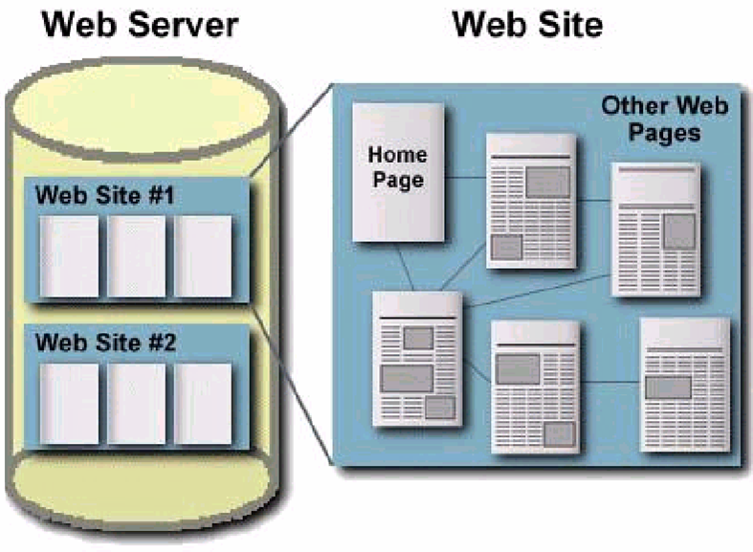
Web Server / Web Site
Web pages
= html
Graphics
= gif, jpg
Other files
=pdf, ppt, doc, txt, exe, zip
Web site = the content
Web server = computer with server software and reliable Internet connection
Notes:
29

Slide 13


A More Complex Environment
User Browser
Online Hosting
typed form
Application server
Web server
page ← data
Internet users interact with web server
Web server query is passed to a database
Database content is displayed in a TEMPORARY web page, created in response to USER-actions
Most database content is unreachable by search engines
Notes:
30

Slide 14

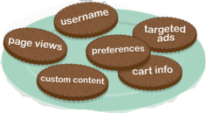
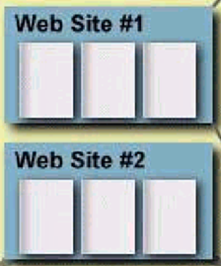



Accessing a Web Page
1. Browser requests URL: http://www.company.com/sales/gadget.html
2. Domain name look-up: root → .com → company.com → IP #
company.com
3. Connect to web server
sales
4. Web page – Text
gadget.html
5. graphics, video, cookies
logo.gif
6. Browser displays downloaded content
“Page not found”- Try shortening the URL
Notes:
30

Slide 15
Course Outline
specific_page.html
Introduction to Internet Architecture
“Persona” issues
Search: Search Engines
Search: “User pages”
Search: Specialized Tools
Source Evaluation
Review / Summary
Online Web page = http://navigators.com/opensource.html

Slide 16






Introduction to “Persona”
persona.html
As users surf the Internet, persona details are transmitted
URL1
Web Server
Analyst
Webmaster
IP#
URL2
Internet
Access
Access
logs
Reports
User is viewing a page (URL1), then clicks to another page (URL2)
The web browser sends “environment variables” to the web server
Webmasters use this information to learn about users, and their organization (physical location, interests, software )
You should understand what websites know about you

Slide 17
Persona Details
persona.html
Know your persona before you visit any website
Should you visit:
badguy.com from agency.gov
Your persona is communicated via “environment variables” such as:
REMOTE_ADDR = IP number of your computer or proxy
REMOTE_HOST = Domain name associated with your IP Number
HTTP_REFERER = URL of the previous page you clicked within
Be careful how you create web pages Do you want to reveal the following :
http://badguy.com is listed on http://intranet.agency.gov/joe_smith/investigation_targets.html
Persona details are also tracked via cookies, beacons, Javascripts, browser plugins, remotely stored objects

Slide 18


A Typical Scenario...
persona.html
searchtool.com
“search terms”
Analyst
webmaster
hits
http://searchtool.com/query=searchterms
page
destination.com
Persona:
- agency.gov OR
- town.ninja.com
webmaster
searchtool.com webmaster knows your “search terms”
destination.com webmaster knows the “search terms” and search techniques used to find them

Slide 19

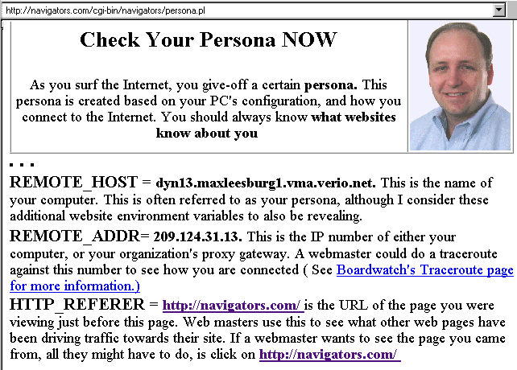
Always Check Your Persona
persona.html
Important note: This test page is most accurate when clicking on a link to arrive at this page
Look for this variable, If this is missing, then no referring URL is being passed via http_referer
REMOTE_HOST: 72-73-23-256.clppva.fios.verizon.net. This is the name of your computer. This is often referred to as your persona, although I consider the following website environment variables to also be revealing.
REMOTE_ADDR: 72.73.23.256. This is the IP number of either your computer, or your organization's proxy gateway. A webmaster could do a traceroute against this number to see how you are connected ( See Traceroute Overview page for more information.)
HTTP_REFERER: www.bing.com/search=haynal+check+your+persona is the URL of the page you were viewing just before this page. Web masters use this to see what other web pages have been driving traffic towards their site.
Several persona testers are listed at: navigators.com/persona.html

Slide 20

Exposing a “less recognizable” persona
persona.html
Analyst #1: uses “agency.gov” persona to visit “targets”
Analyst #2: uses “ninja.com” persona to visit “targets”
Result: “ninja” persona may be recognized as “agency.gov” visitor
The “parallel visit” Problem...
Analyst #1
agency.gov
target.com
Even with no http_referer, a webmaster can still make the association due to high volume hits, usage patterns, software footprint, etc.
Analyst #2
ninja.com
The “portal” Problem...
agency_portal.com/page_names
Analyst #1
agency.gov
target.com
Persona=agency.gov + referrer = portal
Analyst #2
ninja.com
Persona=ninja.com + referrer = portal

Slide 21
Course Outline
specific_page.html
Introduction to Internet Architecture
“Persona” issues
Search: Search Engines
Search: “User pages”
Search: Specialized Tools
Source Evaluation
Review / Summary
Online Web page = http://navigators.com/opensource.html

Slide 22
Course Exercises – Choose your Topic
Search for the same topic throughout the course This enables comparison of results among the various search tools / techniques
Pick a topic you can focus on for 2 days
A combination of lecture, demo, and hands-on exercises will occur for each major search tool:
Lecture – I introduce the search tool/technique
(Please refrain from using your computer)
Demo - I demonstrate the tool/technique
(Please refrain from using your computer)
Individual search – You search your chosen topic
- Be an “explorer”, not a “camper”
- Make bookmarks/favorites, and keep going

Slide 23

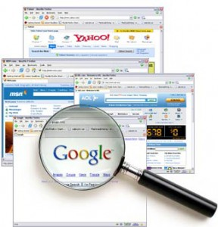
Plan Your Internet Research
search_methodology.html
Spell it Out - Define the topic, key words, acronyms, “what” and “who”
Strategize - Choose the approach, online resources, specific search tools
Search - Get online, stay focused, use advanced search features
Sift - Filter the results, follow the leads
Save – Make bookmarks, take notes, organize results, share with co-workers

Slide 24
Spell out the topic...
search_methodology.html
1. Name of topic, what do you want to learn / desired end-goal
__________________________________________________________________
__________________________________________________________________
2. Spell out the topic (search terms, acronyms, abbreviations)
common, simple terms
obscure, specific terms
_______________________________
_______________________________
_______________________________
_______________________________
_______________________________
_______________________________
_______________________________
_______________________________
3. Make a list of “who” might publish such information
(industry association, government agency, NGO’s, user group, etc.)
__________________________________________________________________
__________________________________________________________________

Slide 25





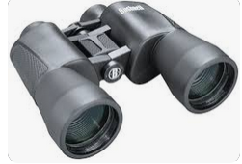
Overview of Search Tools
search_tool_intro.html
Search Engine (Google, Bing)
large database – text from billions of clickable pages
“User Pages” people who “care” about the topic
hundreds of topic-related: links, posts, documents
Specialized Tools
database focused on a specific topic
Pick the right tool...
Every tool has strengths and weaknesses

Slide 26



Search Engines ( google.com , bing.com, ChatGPT)
search_tool_intro.html
Search Engine
copied web page
Web Servers
Your PC
Search
Interface
Indexer
Robot
Robot clicks through simple pages
TEXT of web pages are cached and indexed
Search results are ranked based on the “values” of the search company
Webmaster can block the robot (and web-scraper)
Indexed
TEXT Database
Cached
Web pages
Envision the target page “Use your imagination”
Settings → “search help”, “search settings”, “advanced search”, etc.
Notes:
36
36

Slide 27
Consider Economics of “search hits” vs “AI answers”
search_tool_intro.html
Results
Web Servers
Search Hits
Search Engine / AI
Index / Training
Harvest/ License Content
AI Answer
Database/
Model
Cached
Web pages
How will content creators make money?
( example: nytimes.com/robots.txt )
Notes:
36
36

Slide 28
Class Exercise: Using a Search Engine
search_tools.html
Go to google.com and bing.com
Enter identical terms into both search engines (make sure search terms remain unchanged)
Look through the search results
Which gave more hits?
Are top-ten hits the same?
Add additional specific search terms as needed to focus the search results
Make bookmarks of useful sites

Slide 29

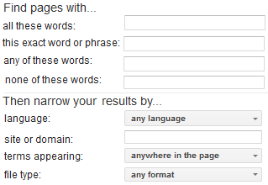
Advanced Search = Efficient Search !
search_tools.html
basic search advanced search
Limit search to specific sites or domains
filetype:pdf = detailed content from great web sites
Bottom right of Google home page: Settings → Advanced Search
Top right of Google search results: → Advanced Search

Slide 30
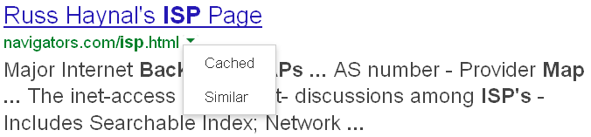
Viewing cached page at Google = poor OPSEC
OPSEC Concerns ( OPerations SECurity)
Target’s site for text and media
Google for text of cached page + Target’s site for embedded media
Viewing “text only” cached web page = improved OPSEC 1) Cut and paste this text into browser address bar:
webcache.googleusercontent.com/search?strip=1&q=cache:
2) Add the target address onto the end of the above string:
webcache.googleusercontent.com/search?strip=1&q=cache:navigators.com/isp.html
Feb 2024: Google removed Cached link !!!
Several months later: webcache address stopped working

Slide 31
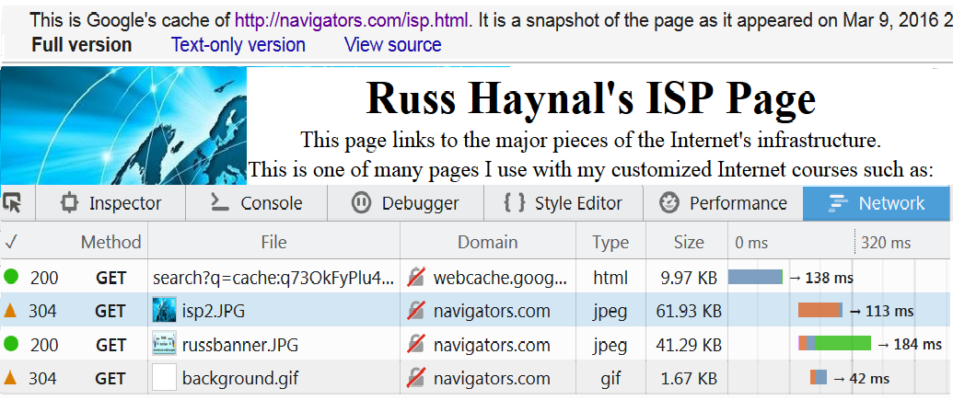
Monitoring the browser’s activity
cached.html
First line gets text (html) from webcache.google.com
Next 3 lines get graphics ( jpeg & gif ) from navigators.com
Firefox → Tools → Browser Tools→ Web Developer Tools → Network
CTRL – SHIFT – I

Slide 32
Course Outline
specific_page.html
Introduction to Internet Architecture
“Persona” issues
Search: Search Engines
Search: “User pages”
Search: Specialized Tools
Source Evaluation
Review / Summary
Online Web page = http://navigators.com/opensource.html

Slide 33
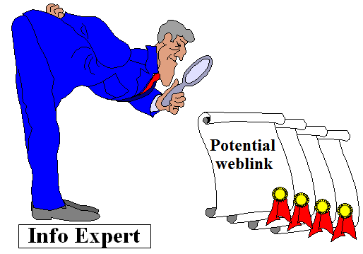
“User Pages”
search_tool_intro.html
Focused on a specific subject
Developed by “experts” in that field (or a person with passion for the subject)
Often contains “the best” online resources

Slide 34











Finding “User pages”
search_universes.html
Subject directory
Groups of users in a forum, conference, journal, club
Contribute to wikipedia, wikimapia
“User pages” point to other “user pages”
Watch for sites labeled: “Joe’s ultimate guide to widgets”
“Surfing Upstream” from several related sites
Ask other researchers – there are several sites that everyone knows as “the best”
Interactive, live communication (Chat, VOIP, virtual worlds)
Notes:
Online Communities as Resources pp. 51-59
When and Why to Use
Using any one of the above communities can be useful if you need to do an exhaustive research on a topic. Newsgroups and mailing lists are generally centered around very specific topics and their followers tend to be experts in their field. News and FAQ archives are a great way to dig up specific technical information.
When posting to an online community for research, proceed with caution. Newsgroup and listserv subscribers are easily annoyed by simple questions or an overabundance of queries in their mailboxes. If you abuse your privileges you may not be openly received.
Because posting a question to an online community requires a human response, it can take a long time to get an answer if you get one at all.

Slide 35
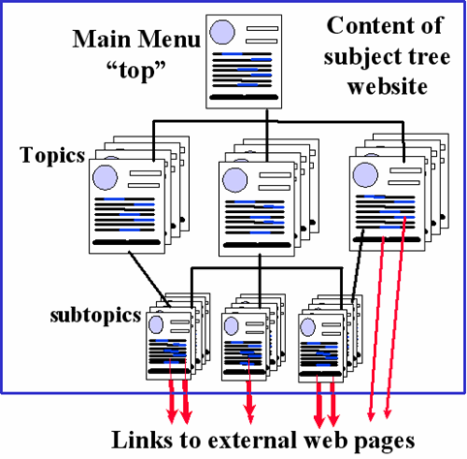

Subject Directory
search_tool_intro.html
Hundreds of links organized by topic and sub-topic
Each link may have a brief description
Search: your_topic directory e.g. golf course directory → www.thegolfcourses.net public records directory → searchsystems.net
General directory: curlie.org

Slide 36

Finding Groups of Users
search_universes.html
Forum – discussion focused on a particular topic
Many users can participate by posting messages
Search : your_detailed_topic forum post replies = threads and posts that discuss your topic
Other ways for users to communicate/collaborate…
Gatherings: conference , convention, symposium , summit, seminar, expo, “trade show”, festival , workshop
Publications: journal , magazine , “white paper”, thesis
Membership: consortium, association, federation, society, club, league, “user group”, alumni
Search: your_topic conference , your_topic festival, journal, etc.
Individual: resume, Curriculum Vitae, CV, biography
Reminder: membership requirements are a barrier to search engines

Slide 37


Wiki ____
A Wiki allows immediate creation and editing of pages by “anyone”
Wikipedia.org – encyclopedia that can be instantly edited by ANY Internet user
Good starting point for many subjects to gain an overview of the topic
Page can be biased from the most recent editor
Some entries get “locked-down” due to vandalism
← Owners based in Russia
old.wikimapia.org – same concept applied to maps
“map type”→ google map: zoom to the right location
“map type” → “wikimapia classic” : to see comments
To learn about the author: click on a comment box: menu → history → the user’s name → stats → click on the statistics numbers = places that user has added/edited

Slide 38



Will The Target Notice You?
search_tools.html
Assess a website’s popularity and demographics before visiting the site
How many hits can be made on the target’s webserver, without causing a noticeable spike in their traffic?
What geographic persona and software persona hits are most commonly occurring on target’s webserver?
What 1-click history could be “leaked on purpose” and not raise suspicions?
Most analytic sites are expensive, but some offer enough free statistics to be very useful for tradecraft purposes:
Discontinued May 1, 2022
Headquarters in Israel
Headquarters in San Francisco

Slide 39
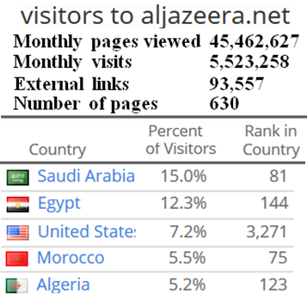
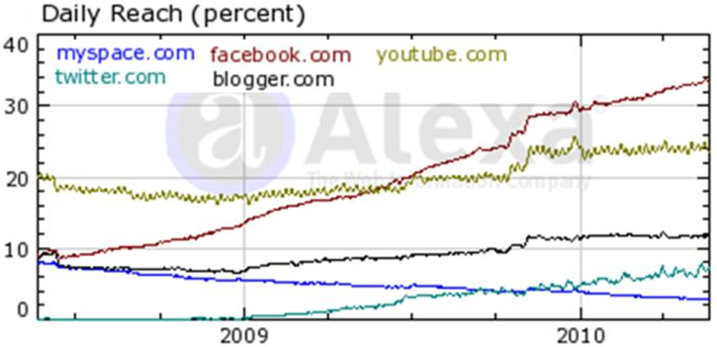
Web Analytics
search_tools.html
similarweb.com/website radar.cloudflare.com
Each of these tools offer a sampling of analytics for free:
Popularity of a web site
Audience demographics
Search terms used to find the site
Visitor engagement levels
Traffic history
Related sites = more sites
Enter a domain name (not search terms)

Slide 40
Surfing Upstream vs. Downstream
search_upstream.html
Target.com
“Upstream”
“Joe’s guide to MANY targets”
#1
#3
#2
Target.com
Target.com
Target2.net
#1 Most researchers follow the links “downstream” from an interesting page
#2 Shows pages that link towards the target (=upstream) This is an Indication of the page’s “popularity” = who knows about target.com
#3 Shows pages that link to both target sites … = “user pages” for that topic

Slide 41
Be Creative When Surfing Upstream Example: Washington DC Tourist Sites
search_upstream.html
Theatre links
Museums /
Educational
DC Tourism
“fordstheatre.org”
“nasm.si.edu”
(air & space museum)
“kennedy-center.org”
“spymuseum.org”
Any combination of these target pages will lead to “DC Tourism” pages, but certain pairings may also lead to subject-specific pages

Slide 42
Surfing Upstream Details
search_upstream.html
search format at google or bing | search results
“www.example.com” | contain text: www.example.com
“www.example.com/pageA.html” | contain text of the specific page address
+“www.example1.com” +“www.example2.com” | contain text of both web site addresses This is a great way to discover “user pages” (e.g. Joe's guide to many example-sites)
Which scenario makes more sense for your scenario; Row #1 or Row #2 e.g. who links to the home page of the entire site vs who links to a specific webpage within the site
A 3rd and 4th site can be added if they are popular enough
Note: do not include “http://” (can also omit www)
Who links to: 2 gov agencies, 2 companies, 2 conferences, 2 technical journals, 2 phone books, 2 hacker sites, 2 social media search tools, etc

Slide 43

Searching Within a Site or Domain Name
search_upstream.html
search format at Google | search results
site:example.com | pages hosted on any example.com servers (www.example.com, blog.example.com, etc) = quick way to assess the public size/depth of a domain
site:example.com searchterm | pages hosted at example.com which mention "searchterm"
site:ru searchterm | pages hosted on .ru servers which mention "searchterm"
site:ac.ru nuclear | pages hosted on any academic .Russian servers which mention nuclear
site:iaea.org iran filetype:pdf | PDF documents hosted at iaea web servers which mention iran
site:linkedin.com/in topics | Individual Linkedin profiles that mention your topics
Faster than reading thousands of pages from a large site
No space after site:
Do not include “http://” or “www”
“use your imagination” to focus these searches

Slide 44








Who Knows About Your Topic? (Google search terms are in red)
search_upstream.html
Example: Iranian cell phone company (Irancell-MTN)
Topic’s own website
Marketing information
Press announcement
site:irancell.ir
Equipment vendor
Phones, networks
Press announcement
site:nokia.com iran
Government
Regulations, license
site:gov.ir irancell
Employees
Resumes,
Job Postings
resume irancell
site:linkedin.com/in irancell
site:facebook.com irancell
Industry Magazine
News, vendors, maps,
Management interviews
site:totaltele.com iran
Resume’
Construction vendor
Towers, networks
site:vendorname.com iran
Customers
Service issues,
technology insights
Irancell forum post
site:mob.ir irancell
Investors
Ownership, disclosures

Slide 45
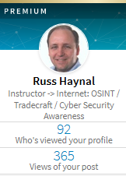
Cautions about Social Media
Confirm policies for viewing, joining, or interacting on social media
Understand each site’s different levels of interactions: - viewing, following, group member, connecting, friend, messaging
What information is shared to the other end user?
What information is shared with 3rd party advertisers / data brokers?
ALL interactions are known to the owner of the social media site --> learn who owns the site
Who has “jurisdiction” over the site? (VK → Russia, QQ → China)
Linkedin example:
Different membership levels have various capabilities
free ($0/month), premium, premium personal, premium career, sales navigator, recruiter lite, recruiter ($900/month)
“recruiter” has unlimited access to everyone’s full profiles, and leaves no “hits” on the people they view
Free account = YOU are the “product” being sold!

Slide 46
Alternative Techniques
Web analytics: Assess Popularity, choose “access point”, 1-click history
= your browser → google.com or bing.com
“target.com” –site:target.com = # of outside pages” pointing to target.com
“target.com” site:de = # of .de pages pointing to target.com
“target.com” site:fr = # of .fr pages pointing to target.com
OPSEC Issues…
Mobile Friendly test ( https://search.google.com/test/mobile-friendly )
“Testing Live URL” = Google mobile tester→ target.com
HTML viewer ( https://htmledit.squarefree.com )
Cut and paste HTML from another source ( e.g. Mobile friendly test)
= your browser → target.com hits for graphics, etc!!!
https://pdfmyurl.com/ = PDF My URL → target.com
https://archive.org = way back machine → target.com/robots.txt

Slide 47
Course Outline
specific_page.html
Introduction to Internet Architecture
“Persona” issues
Search: Search Engines
Search: “User pages”
Search: Specialized Tools
Source Evaluation
Review / Summary
Online Web page = http://navigators.com/opensource.html

Slide 48





The “clickable web” is TINY
search_tool_specialized.html
Total online material
Specialized
Databases
World Wide Web
(Clickable pages)
Email
1. Initial Search
= 1000X larger
than the web
Search
Engines
2. Detailed Search
Blogs
Forums
Multi-
media
Closed systems
© navigators.com
Many detailed searches are a two-step process
find the specialized database
then type appropriate query into that database
Notes:
37
37

Slide 49

Lists of Databases
search_tool_specialized.html
For specific info, use a specialized database
Over 100,000 specialty databases
70,000 public record databases
Search for the organization that would host the specialized database
Try searching: your_topic database
patent database → patft.uspto.gov
arms transfer database → sipri.org/databases/armstransfers
fish database → fishbase.org
Specialized databases contain content that search engines can’t reach

Slide 50



Business databases can be quite useful
search_tool_specialized.html
Most publicly held companies are required to file financial statements with the Securities Exchange Commission
These filings are accessible to the public through the SEC’s EDGAR database
READ forms 10-Q and 10-K (quarterly and annual report) Detailed reports about the company’s activities, plans, sales, etc
Seek out other business databases: financial, investment, government regulatory, etc
Databases may be available at your library (internal or public)

Slide 51

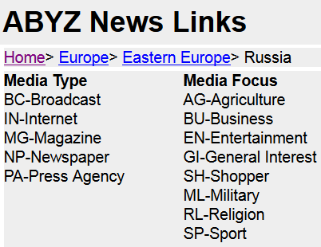
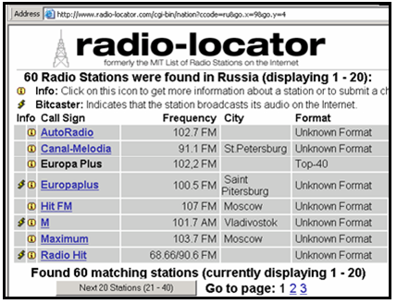
Many country resources are online
country_specific_content.html
Assess popularity of resources using web analytics
If necessary use site:
wayp.com

Slide 52




Lists of OSINT Resources
search_tool_specialized.html
“OSINT Resources” can be found using Hidden Universes techniques: (eg. surfing upstream, filetype:pdf, OSINT guide, OSINT Handbook, toolkit, conference, journal)
https://i-intelligence.eu/uploads/public-documents/OSINT_Handbook_2020.pdf = 500 pages of OSINT hyperlinks
https://metaosint.github.io = Directory of 4,000 OSINT resources https://metaosint.github.io/chart ← explore visually https://metaosint.github.io/table ← searchable text listings
https://bit.ly/bcattools = Bellingcat’s online investigation toolkit ( click on tabs along bottom of spreadsheet)
https://inteltechniques.com/tools/index.html = A supplement to book: OSINT Techniques by Michael Bazzell

Slide 53
Course Outline
specific_page.html
Introduction to Internet Architecture
“Persona” issues
Search: Search Engines
Search: “User pages”
Search: Specialized Tools
Source Evaluation
Review / Summary
Online Web page = http://navigators.com/opensource.html

Slide 54

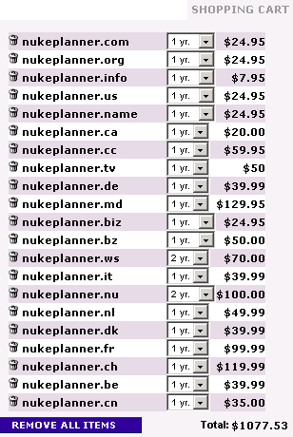

Most Countries Sell Their Domains
domain_name.html
These were just some of the country domains available for sale
“All Domains” happened to be a licensed “registrar” for these countries
Most countries sell their domain names to “anyone”

Slide 55
Learn About the 2-letter code
domain_name.html
Visit your county’s domain name registrar
iana.org/domains/root/db
What is the policy for getting a domain name? (citizenship, trademark, local presence, money)
What is the cost to register a domain name?
Are there any censorship clauses?
Does the registrar require any proof of identity? (drivers license, passport, business license)
Is there a whois service? (make a bookmark)

Slide 56
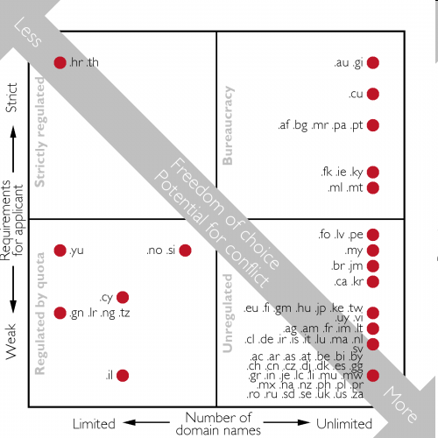
www.norid.no/en/regelverk/regelverksmodeller
domain_name.html
An analysis of domain name policies
Most countries sell their domain names to “anybody”

Slide 57

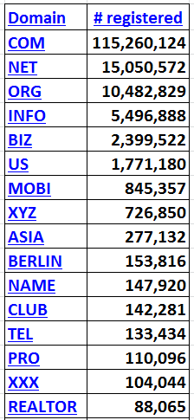
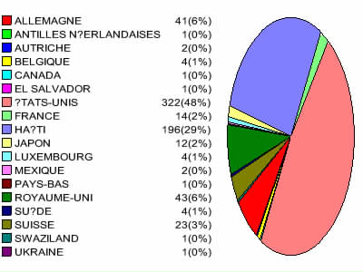
Domain Names for Sale
domain_name.html
Only 29% .HT domain names were registered to people with a Haitian address
48% of Haiti’s Domain names were registered to U.S addresses
When you see a .ht website… is it necessarily foreign?
Postal address for .HT Domain Owners
Haiti
United States

Slide 58
Source Evaluation
sesseval.html
Pick apart the URL:
Determine where “ownership” of the web page begins
www.facebook.com/joesmith/info.html
www.joesmith.com/stuff/info.html
Browse the directories (shorten URL if necessary)
Look at domain’s home page - Is it a web hosting site? Is “pathname” a user account?
IF the domain home page looks like the “owner” of the content, then move forward with whois and traceroute

Slide 59
Source Evaluation - Using WHOIS
whois.html
Domain names are “registered” at Internet registrars (global, country-specific)
Each registrar develops its own policies
may sell to anyone/anywhere (.com, .org, .net, .tv, .pk )
may have strict qualification requirements (.gov, .mil, .au)
Registrants provide “point of contact” information, for at least invoicing purposes
Domain “point of contact” information is often available from the registrars’ database via a “WHOIS” query
WHOIS contents may be inaccurate, although usually the email, or postal address will be correct to receive renewal invoice

Slide 60

Performing a “Whois” Query
whois.html
“whois” reveals the “owner” of a domain (searchenginewatch.com)
Administrative contact: Ron Doobay
HAYMARKET HOUSE
28-29 HAYMARKET
LONDON SW1Y 4RX UK
+44.2074849700 +44.2079302238
dns@incisivemedia.com
Technical contact: Domain Administrator
3rd Floor Prospero House
241 Borough High Street
Borough London SE1 1GA UK
+44.2070159370 +44.2070159375
corporate-services@netnames.com
Created on: 1998-03-20
Expires on: 2026-03-19
Domain name servers:
NS3.INCBASE.NET 85.133.68.200
NS2.INCBASE.NET 62.140.213.136
NS1.INCBASE.NET 62.140.213.135
Spam concerns caused many domain names being registered via “privacy enhanced” options
EU GDPR Law in 2018 impacts WHOIS records for Europeans (General Data Protection Regulation)

Slide 61

Traceroute
traceroute.html
Shows a network path between 2 machines
Traceroute designed to help de-bug network connections
Can initiate traceroute from your workstation, or from public “traceroute servers” located throughout the Internet
Each Internet provider has their own naming convention for their infrastructure
Location labels: City names or 3-letter airport codes
Exchange points (LINX, HKIX, AMS-IX)
Infrastructure Topology (T3, FDDI, GE, SMW3)
A website can be hosted anywhere
Could be at organizations’ building, or more likely at a well-connected hosting facility

Slide 62
Results of Traceroute
traceroute.html
traceroute output from WWW.Telcom.Arizona.EDU to www.nsa.gov:
1 128.196.128.253 (128.196.128.253) 1 ms
2 192.80.43.25 (192.80.43.25) 1 ms
3 192.80.43.58 (192.80.43.58) 1 ms
4 207.250.65.133 (207.250.65.133) 5 ms
5 core-01-ge.phnx.twtelecom.net (209.234.146.45) 5 ms
6 core-02-so.lsag.twtelecom.net (168.215.53.73) 17 ms
7 tran-01-ge.lsag.twtelecom.net (168.215.54.98) 17 ms
8 POS1-1.GW3.LAX1.ALTER.NET (208.222.8.245) 17 ms
9 CL2.LAX4.ALTER.NET (152.63.52.246) 18 ms
10 TL2.LAX9.ALTER.NET (152.63.115.146) 18 ms
11 so.TL2.DCA8.ALTER.NET (152.63.3.193) 74 ms
12 so.XL2.DCA8.ALTER.NET (152.63.35.250) 74 ms
13 ATM6-0.GW3.BWI1.ALTER.NET (152.63.39.41) 76 ms
14 * * *
15 * * *
Time-Warner and Alternet swap traffic at Los Angeles
Baltimore airport code
Traceroute helps reveal the dynamic architecture of the Internet

Slide 63
Try different starting points for Traceroutes
traceroute.html
Times are real-time round trip measurements from step 1 to step #_
Starting from Arizona University
1 128.196.128.253 0 ms
2 192.80.43.25 0 ms
3 192.80.43.58 1 ms
4 207.250.65.133 5 ms
5 core-02-ge.phnx.twtelecom.net 5 ms
6 core-02-so.chcg.twtelecom.net 46 ms
7 peer-01-ge.chcg.twtelecom.net 46 ms
8 aads.verio.net 47 ms
9 chcgil01.us.bb.verio.net 47 ms
10 chcgil06.us.bb.verio.net 47 ms
11 dllstx01.us.bb.verio.net 47 ms
13 stngva01.us.bb.verio.net 82 ms
17 navigators.com 82 ms
Starting From University of Maryland
1 Vlan5.css-core-r1.net.umd.edu 0.53 ms
2 128.8.1.222 0.43 ms
3 qwest-bdr.net.umd.edu 1.49 ms
4 63-237-64-1.cust.qwest.net 1.38 ms
6 dca-brdr.inet.qwest.net 1.48 ms
7 qwest.stngva01.us.bb.verio.net 2.45 ms
9 ge.stngva01.us.verio.net 3.09 ms
10 stngva01.us.verio.net 2.75 ms
11 navigators.com 2.48 ms
The speed of light can serve as a yardstick in traceroutes
Speed of light:
186,000 miles/sec (in vacuum)
120,000 miles/sec (in glass fiber) = 120 miles/ms (in glass fiber)
Navigators.com “must” be near University of Maryland’s server
2.48 x 120 / 2 = ~150 miles
Note: Each hop via geostationary satellite must take at least 240 ms
Low-Earth satellites can have lower latencies than terrestrial networks

Slide 64
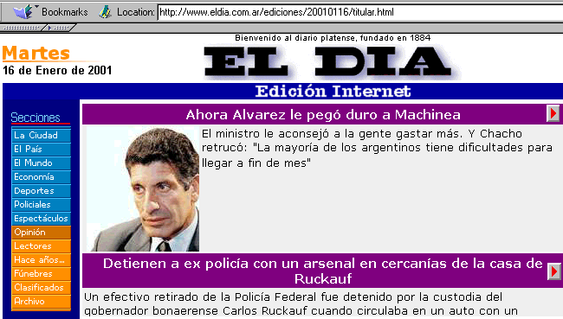
A Foreign Newspaper ??? URL = http://www.eldia.com.ar
traceroute.html
“.ar” implies the site is from Argentina?
Traceroute reveals this website is physically hosted in the U.S.
Chicago, Illinois
Sterling, Virginia
wh = web hosting
traceroute from WWW.Telcom.Arizona.EDU to www.eldia.com.ar:
1 woody-netops.telcom.Arizona.EDU (128.196.128.1) 1 ms
…..
8 peer-01-ge.chcg.twtelecom.net (168.215.53.194) 46 ms
….
10 r01.chcgil01.us.bb.verio.net (129.250.2.254) 48 ms
11 r02.stngva01.us.bb.verio.net (129.250.5.103) 83 ms
12 ge.r0728.stngva01.us.wh.verio.net (129.250.27.219) 81 ms
13 ge.stngva01.us.wh.verio.net (161.58.129.13) 81 ms
14 noticiasargentinas.com (161.58.165.155) 80 ms 80 ms 81 ms

Slide 65
Course Outline
specific_page.html
Introduction to Internet Architecture
“Persona” issues
Search: Search Engines
Search: “User pages”
Search: Specialized Tools
Source Evaluation
Review / Summary
Online Web page = http://navigators.com/opensource.html

Slide 66







Each Search Tool is Different
Each search tool has it’s own unique set of defaults and options
Take the time to learn the options of each tool
Don’t assume anything
These tools are competing, trying to be unique
Read the help

Slide 67
Search - Review
Stay organized in your search
(spell, strategize, search , sift, save)
Be conscious of the type of tool you are using (and read its help)
The “right” search terms, placed correctly into the “right” search tool, should quickly yield “good” results
Discover the best “user pages” and online communities for your topic - follow their leads (They have already weeded through the junk)
OSINT handbooks, genealogy search sites,

Slide 68
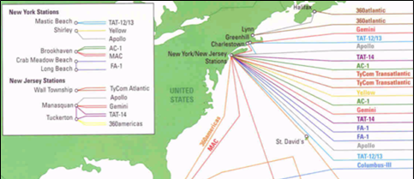
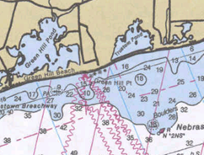
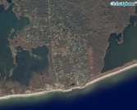
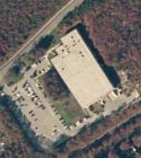
Several Open Sources can be Combined to Build a Complete Picture
Satellite imagery follows cable
Nautical charts show exact cable locations
Start with a simple cable map
FCC Filings, Building Permits, etc. provide additional details:
fcc.gov filings: “12. C&W USA states that the Apollo Cable landing stations in the United States will be located in New York and New Jersey. In New York, the cable landing station will be located in Tritec Park, Brookhaven Technology Center, Shirley, New York, at coordinates 40º 50 minutes 30 seconds north and 72º 53 minutes 4 seconds west.”
Newspaper / Building Permit Section: “USA Apollo Cable Landing Station, Ramsay Rd. and Precision Dr., site plan-land division station, construct 25,573-square-foot one-story building to house computer equipment for a fiber optic cable landing station on one lot of a two-lot land division in Phase 1. External generators and associated above-ground vaulted diesel fuel tanks to be installed in Phase II. Cable & Wireless USA, Shirley.”
Here is the cable landing station
Reference: http://cryptome.org/eyeball/cable/cable-eyeball.htm

Slide 69


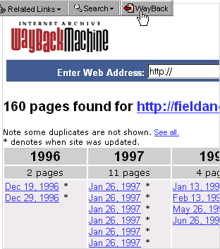
web.archive .org
persona_example.html
copied web page
Web Servers
User PC
User
Interface
Robot
Archive.org robot collects web pages like other search engines
Previous web page copies are not deleted
Recent
copy
Archive copies
Surf through previous copies of a web site
Deleting sensitive information from today’s web server does not remove it from archive.org
“document not found” – Paste the address into archive.org
Viewing archived web pages will cause hits to live target website

Slide 70
The Future of the Internet
transport
Content
Consumer
of content
Types of content
Information, entertainment, business, leisure
Content origins
corporations, hollywood, other people
Content formats
text, audio, video, interactive reality
Transport mechanism
Phone line (copper/fiber), coaxial cable, wireless, direct satellite, electric lines
Mergers and acquisitions are occurring horizontally and vertically
Notes:
48

Slide 71
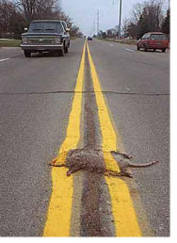
Summary
Internet contains a large, fragmented information space
Search engines are limited to billions of “clickable” pages
The best content is organized by “people without lives”
The Internet will transcend all other communication technologies
Change is the only constant
The Future is Clear...
Master the Information Superhighway
or
Become Roadkill

Slide 72
Hidden Universes Links
Persona: ipleak.com/full-report whoer.net browserleaks.com coveryourtracks.eff.org amiunique.org/fingerprint
Search tools: google.com google.com/advanced_search bing.com chatpgt.com wikipedia.org old.wikimapia.org unclaimed.org Searchsystems.net
International searchenginecolossus.com abyznewslinks.com/allco.htm radio-locator.com wayp.com
OSINT tools: metaosint.github.io bit.ly/bcattools inteltechniques.com/tools i-intelligence.eu/uploads/public-documents/OSINT_Handbook_2020.pdf
Analytics: radar.cloudflare.com similarweb.com/website
WayBack machine: web.archive.org
Source Evaluation: iana.org/domains/root/db traceroute.org who.is search.arin.net db.ripe.net/whois afrinic.net/whois lacnic.net/cgi-bin/lacnic/whois wq.apnic.net/static/search.html

Slide 73
Security and Privacy Links
Security and Privacy Issues: annualcreditreport.com
Download your data: facebook.com/settings?tab=your_facebook_information www.linkedin.com/mypreferences/d/download-my-data takeout.google.com
Detailed Privacy Guides: - odni.gov/files/NCSC/documents/campaign/DoD_IAPM_Guide_March_2021.pdf
- www.socom.mil/Documents/SOCOMSmartcards.pdf - www.soc.mil/IdM/publications/docs/general/Id_Privacy_Full.pdf - www.pa.gov/content/dam/copapwp-pagov/en/pccd/documents/victim-services/documents/2023-stop-conference/digital_exhaust_guide-law_enforcement_partners_version_2.0_final.pdf
Trackers: whotracks.me
Watch: “The Social Dilemma” on Netflix

