Slide 1



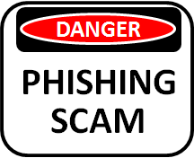



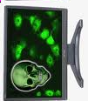


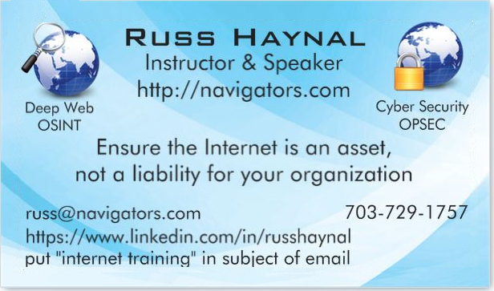
Hidden Universes /
Security and Privacy Issues
Day #3
Revision 02/2026
Note: If you send me an email, put “internet training” in the e-mail's subject
Copyright © Information Navigators

Slide 2
Security and Privacy Issues
specific_page.html
Background and Statistics
Network connections ( at work and home )
Firewalls, Anti-Virus
“Persona” details and options
Tracking you cyber: web browser, email, social media
Tracking you physical: phone, internet of things
Critical Advice and Summary
Online web page = http://navigators.com/issues.html

Slide 3

An Opening Survey
What type of Internet connection(s) do you have:
- attributable (agency.gov, yourcompany.com), mis-attributable, home
Have you researched work-related topics via your home account?
Is there a WIFI network in your SCIF?
Is there a WIFI network in your home?
Do you access the Internet at home without a firewall?
Do you, or anyone in your extended family, use a genealogy program (e.g. Family Tree Maker)
Do you, or anyone in your family, use social media?
Have you ever clicked on an email link or attachment?
What apps in your phone can access GPS / wifi / bluetooth?
How many microphones are in your house? Are you sure?

Slide 4
Why this Session…
This session covers a variety of security and privacy issues
Many issues apply directly to work-related Internet usage
Some issues apply strictly to home/mobile Internet usage
These issues are important from a counter-intelligence perspective
Minimize “leaking” of your research interests
Protection of your personal information and identity
If security of your personal Internet devices are breached, you could be in a compromised/vulnerable situation
Internet = Passport to interact with foreign resources and people

Slide 5
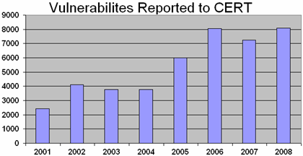
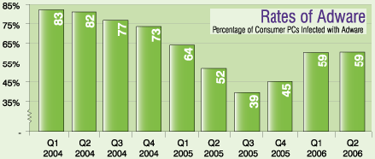
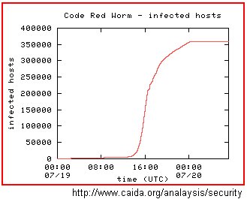
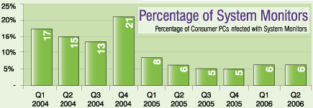
These historic stats are based on PC’s History is repeating with ‘Internet of things”
privacy.html
Privacy Practices of Web Domains
 | Random Sample | Top 100 Popular
Collect Personally Identifiable Information | 90% | 96%
Places Third Party Cookies | 28% | 48%
Posts Privacy Statement | 88% | 98%
Displays Privacy Seal (ie. Truste, BBB) | 12% | 44%
Source:http://www.pff.org/publications/privacyonlinefinalael.pdf
source: www.cert.org/stats
source: webroot.com

Slide 6

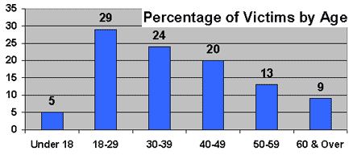
Identity Theft
privacy.html
12 million victims annually in the U.S. Average loss = $5,130 100+ million user records stolen (Target, Anthem, OPM, Equifax)
Identity theft occurs when someone has collected enough personal information about you, that they can “impersonate” you
They access your existing financial accounts, investment accounts
They establish new accounts (checking, credit card, loans)
They collect your personal Information through traditional means – dumpster diving, scam solicitations, corrupt employee.
Hacker gains access to your PC: account #’s, investment software, cookies, auto-complete password, and family genealogy
Researches Facebook and public databases
Free credit report every 12 months from each of the 3 credit bureaus
Annualcreditreport.com or call 1-877-322-8228

Slide 7
Internet Connection Definitions
getting_connected.html
IP address - Internet Protocol address allocated to you from your ISP
Fixed IP address - the same IP address remains permanently assigned
Dynamically assigned IP address – During a log-in/connect sequence, an IP address is assigned for the duration of that session. Such IP addresses may be assigned from a “DHCP” Host (Dynamic Host Configuration Protocol)
Dial-up – only connected part-time. Dial-up accounts received dynamically assigned IP address
Broadband – FIOS /Cable/DSL Connected 24 X 7 A broadband account may receive a fixed or dynamic IP address A dynamic IP address may persist for a very long time

Slide 8
Network Address Translation
getting_connected.html
NAT is the translation of an IP address from one network segment into an IP address that is used on another network segment
NAT is often used where a private network touches a public network e.g. Internet → broadband modem → local network
Certain IP addresses are reserved for use on private networks (reference: RFC’s 1918, 1631)
10.0.0.0 - 10.255.255.255
172.16.0.0 - 172.31.255.255
192.168.0.0 - 192.168.255.255
192.168.0.5
“local”
“external”
192.168.0.83
NAT Device
68.70.164.89 ←→ 192.168.0.1
To see your “external” IP address: “check your persona” on my web site
To see your computer’s “local” IP address: DOS prompt → ipconfig /all

Slide 9


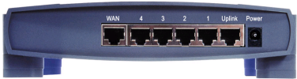
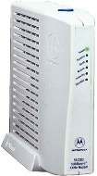

Getting Online…
getting_connected.html
At Work….
Wide variety of implementations including firewalls.
Local
Routers
High speed
Router
Employee PCs
Home options
Dial-up modem with a single PC
- Temporary connection
- Dynamically assigned IP number
Phone
Modem
ISP /
Internet
Broadband (Cable/DSL/fiber) with a single PC
- Persistent connection
- IP address remains constant throughout “session”
Broadband
Modem
Broadband modem with multiple PCs
- “Internet gateway router” includes extra features: DHCP and NAT to assign additional IP addresses to all computers; firewall, print server, wireless
- Modem’s IP address = Internet persona
Gateway
Router
Broadband
Modem

Slide 10
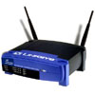
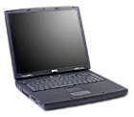



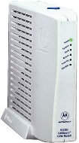
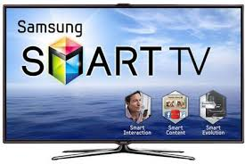
A special note about wireless networks (are you sure, you can’t install a wire?)
getting_connected.html
Remote “guests” may connect into your local network
Wireless networking standards are always evolving: 802.11b, 802.11g, 802.11n, 802.11ac, 802.11ax
WEP (Wireless Equivalent Privacy) has a weakness in its algorithm. WEP can easily be compromised using free shareware WPA / WPA2 / WPA3 (WIFI Protected Access) adds security
Wireless
Router
Neighbor’s computer /
smartphone
ISP /
Internet
Broadband
Modem
Router
Comcast Modems are now Public WIFI Hotspots!
Read the manual for your router and UPDATE the firmware

Slide 11
Security and Privacy Issues
specific_page.html
Background and Statistics
Network connections ( at work and home )
Firewalls, Anti-Virus
“Persona” details and options
Tracking you cyber: web browser, email, social media
Tracking you physical: phone, internet of things
Critical Advice and Summary
Online web page = http://navigators.com/issues.html

Slide 12

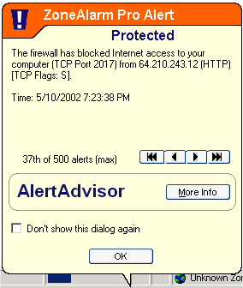
Personal Firewalls
firewall.html
A firewall should monitor incoming and outgoing traffic
Some firewalls are more secure than others (stateful packet inspection, ICSA Certified, etc)
Most firewalls do not protect against viruses
All firewalls require administration (set-up configuration, updates, granting permissions for applications)
Change the default administrative password included in the firewall
Event logs – learn how to read these
You can traceroute IP addresses and search for info on port numbers

Slide 13

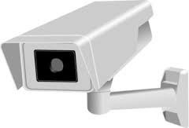
Firewall Options
firewall.html
Broadband
Modem
Broadband
Modem
Firewall
(hardware)
Router
Router
Firewall
(Software)
Firewall
(Software)
Cost: <$100 to ~$500
Additional functions available
NAT, DCHP, Email notification
Easier for computers to locally share folders / printers
Can protect other devices
Cost: free to ~$50 per computer
Each machine needs to be configured
Firewalls may interfere with local network sharing
What about other Internet devices?

Slide 14

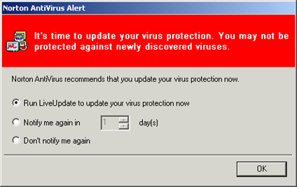
Anti-Virus Software
virus.html
Every machine should have updated anti-virus software installed, and running
AV software should automatically examine every incoming file ( email attachment, web download, peer-to peer download)
AV software will occasionally scan every file on your machine for viruses
The heart of most AV programs is a “dictionary” of pre-defined viruses which is compared to your files. The dictionary may have over 1,000,000 definitions.
AV programs will also monitor certain sensitive system resources for any changes
Important: the virus definition dictionary must to be updated frequently. There may be 100 new virus definitions added to the dictionary in one week.

Slide 15
Security and Privacy Issues
specific_page.html
Background and Statistics
Network connections ( at work and home )
Firewalls, Anti-Virus
“Persona” details and options
Tracking you cyber: web browser, email, social media
Tracking you physical: phone, internet of things
Critical Advice and Summary
Online web page = http://navigators.com/issues.html

Slide 16

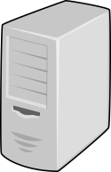


A Typical Scenario...
persona.html
searchtool.com
“search terms”
Analyst
webmaster
hits
http://searchtool.com/query=searchterms
page
destination.com
Persona:
- agency.gov OR
- town.ninja.com
webmaster
searchtool.com webmaster knows your “search terms”
destination.com webmaster knows the “search terms” and search technique you used to find them

Slide 17
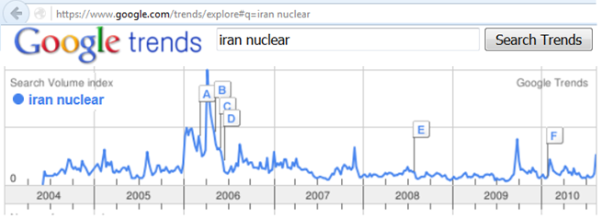
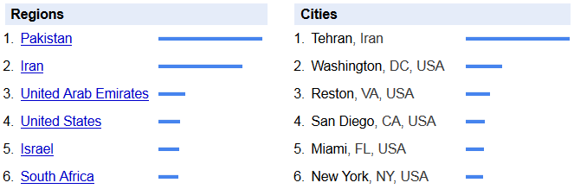
Search Tools are Tracking You
Most search tools keep a long, detailed history of “all user activities”
What do ALL searches from ALL your co-workers look like to a particular search tool webmaster?

Slide 18
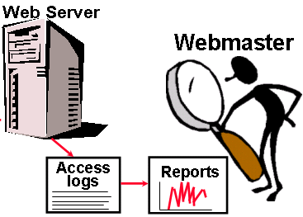
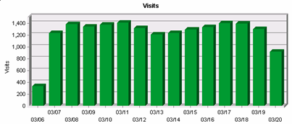
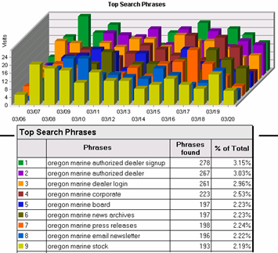
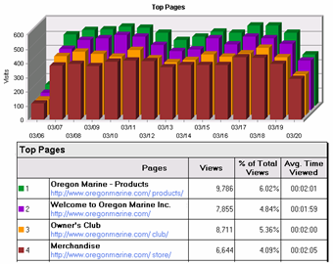
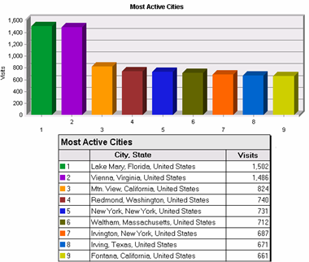
Web Site Log Analysis
persona_connection.html
There are many standard reports that a webmaster can run

Slide 19
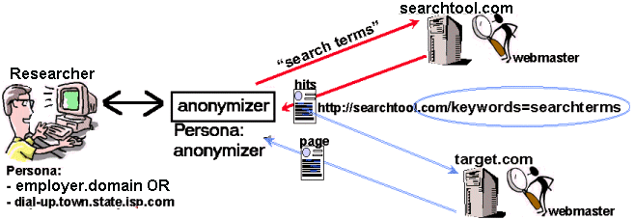




Anonymizers, VPN, Virtual platforms
anonymizer.html
Anonymizers replace your persona with their persona
Anonymizer now “knows your business”
Webmasters may recognize anonymizer traffic

Slide 20
What Kind of Persona do you have?
Agency.gov (or branch.mil) – All web masters will easily recognize your users as members of your organization
“non-attributable” – Do NOT use the phrase “non-attributable”. It may give the organization’s users a FALSE sense of security/invincibility, and will cause them to take excessive risks with their internet account. A more accurate label would be: “less recognizable”
“less-recognizable” - This is an alternative persona/gateway which may not be “easily” associated with the organization. Possible concerns:
Many co-workers share your persona
Other “neighbors” of your persona
How frequently does the persona change ( annually? monthly?)
Persistent Cookies, Third-party Cookies
Does it leak http_referrer
User surfing activities = the same as agency.gov users?

Slide 21
Internet Accounts, Policies, & Procedures
Each type of Internet account has its own intended use, strengths and weaknesses
Some Internet usage policies always apply
There may also be unique policies associated with each type of account
Policies are in a state of flux, as organizations try to keep up with the ever-changing Internet and legal environment
Clarify these issues from within your organization
Make sure ALL Internet users are kept aware of the latest internet usage policies. Mistakes by a handful of users could jeopardize your connection’s privacy, and cause unwanted publicity for your organization

Slide 22
Security and Privacy Issues
specific_page.html
Background and Statistics
Network connections ( at work and home )
Firewalls, Anti-Virus
“Persona” details and options
Tracking you cyber: web browser, email, social media
Tracking you physical: phone, internet of things
Critical Advice and Summary
Online web page = http://navigators.com/issues.html

Slide 23
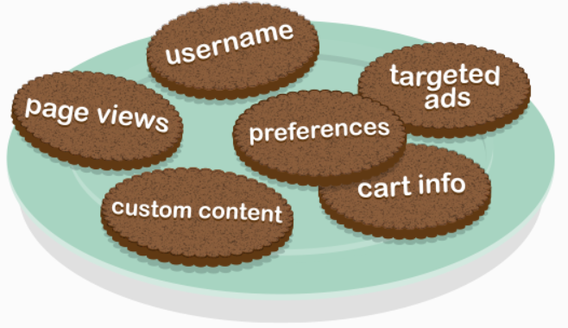
Cookies
cookies.html
xyz.com
abc.com
def.com
ad_cookies
xyz_cookie
Browser
A cookie is a piece of text stored in your computer/device
It enables the web site to “recognize you” (username_greetings) and “remember” your interactions within the site (logged-in → shopping cart → checkout)
Web site will repeatedly refer to your cookie and update its internal database of your online actions
3rd parties also place cookies on MANY web sites (advertisers, Google, Facebook, etc)

Slide 24
Are you visiting just one site?
cookies.html
Page1.html
Page2.html
Page2.html
Logo.gif
Cookies
Scripts, etc
Ad_banner.gif
Cookies, etc
Tiny_dot.gif
Cookies, etc
facebook.gif
Cookies, etc
Viewing a single page may cause your browser to interact with many different web servers
Even with cookies turned off, you still make foot prints on third-party web servers while retrieving their graphics

Slide 25

Third Party Cookies
cookies.html
Most web pages include graphics/cookies/beacons from “third parties”
3p.com
Jokes.com
Joe_nobody
joe@hotmail.com
Viewing history
Buys/sells your data with its “partners”
loan.com
Real_Name
Real_N@isp.com
Address_phone
Viewing history
Jokes.com
Joe_nobody
joe@hotmail.com
Your viewing history
Your Cookies
loan.com
Real_Name
Real_N@isp.com
Address_phone
Your viewing history
Jokes.com ID#_201
loan.com ID#_4873
badplace.com ID#_539
badplace.com
Fake Name
Faker@hushmail.com
Your viewing history
3p.com ID#_435349
badplace.com
Fake Name
Faker@hushmail.com
Viewing history
Copyright navigators.com
The “third party site” compiles an extensive profile on you, and sells this information to companies that are online and offline.
Google Analytics is embedded in 50% of the top 1 million websites

Slide 26
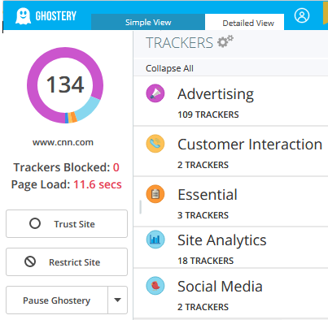
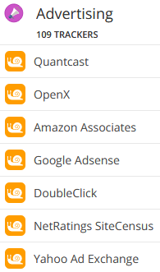
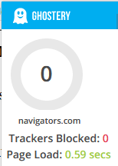
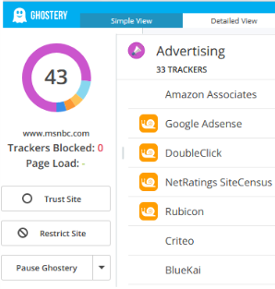
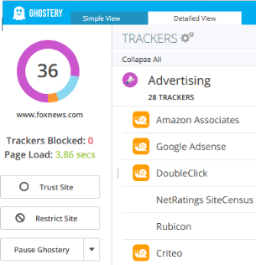
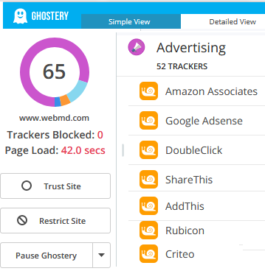
Trackers… https://whotracks.me

Slide 27
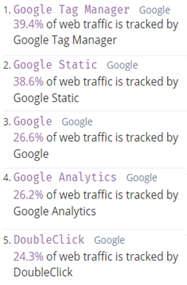
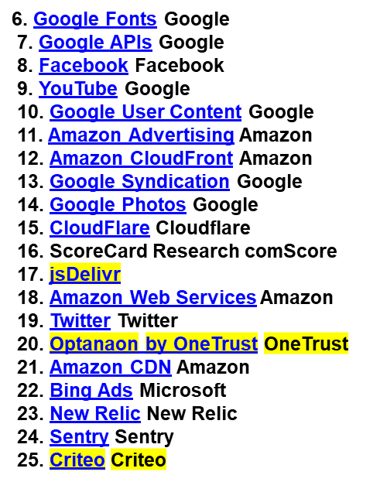
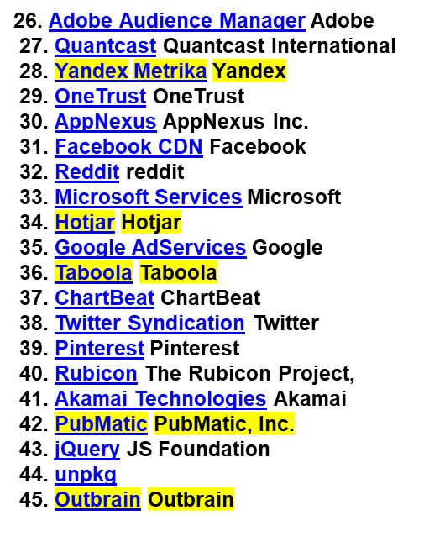

~850 Trackers listed at: whotracks.me
cookies.html
Highlight = Possible foreign ownership!
Data sold to: advertisers, politicians, government bureaus, Intel agencies, any bidder?
of the top 10,000 sites seen loading the Google Tag Manager tracker

Slide 28

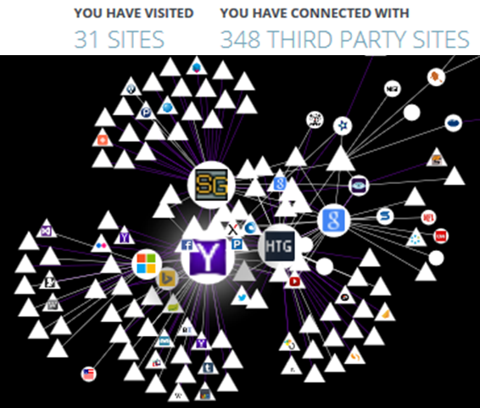
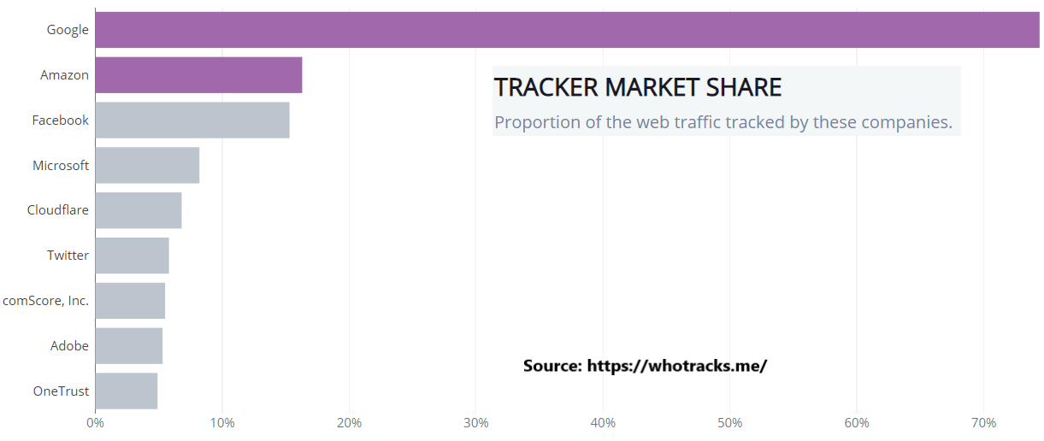
Web Bugs and Beacons
cookies.html
Web bugs are “hidden” graphics
The graphic is usually a 1 x 1 pixel and is the same color as the background
Some web privacy policies refer to web bugs as “beacons”
Firefox plug-ins Ghostery and Lightbeam reveal MANY beacons

Slide 29
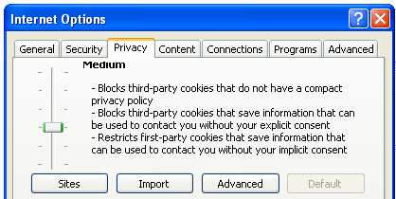
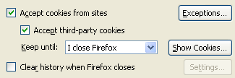
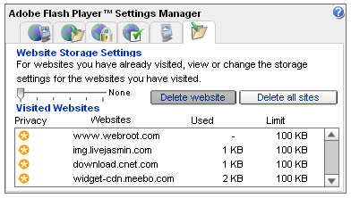
Managing Cookies
cookies.html
Browsers have several settings to control cookies
Tools -> Options ( or Internet options )
You can allow cookies from specific web sites, while blocking most other sites.
There are other types of trackers such as “remotely stored objects”

Slide 30
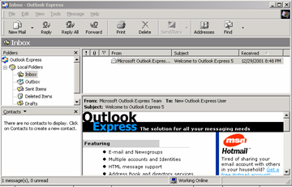
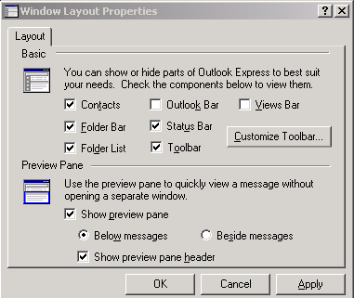
Reading Email = Web Surfing!
privacy_other_apps.html
Graphics downloaded as you preview/display an email
Most graphics are downloaded from an online server as you view email
The spammer now knows that you have read his email
Ways to avoid this:
Disable HTML, preview options
Transfer webmail in to spam/trash folder and then view email
Block Internet while browsing downloaded email

Slide 31

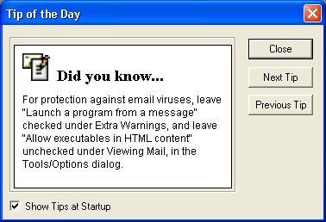
Email issues
privacy.html
Default email program settings may leave you vulnerable
Viruses often transmitted via address books (don’t trust any attachment – even from your friends)
Spam – Do not reply to get “removed”
Scams – nigeria money scam – Give us your bank account number
Hoaxes - $300 cookie recipe, boy brain tumor, modem tax, etc.
Social engineering – One virus hoax email told you to search for a file and delete it... Unfortunately the file in question is a normal system file
If it says “tell everyone you know”, it IS a hoax. To confirm if it is a hoax, simply search for part of the email using google.
Microsoft outlook – Look for updates, patches and learn about settings

Slide 32
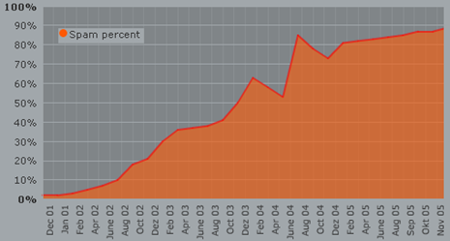
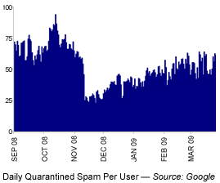
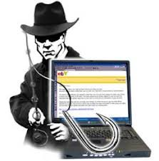
Spam and Phishing
privacy.html
Source: www.junk-o-meter.com
“Phishing” is sent to random users to get them infected or to reveal sensitive data
“Spear-Phishing” is customized to you
“Whaling” is targeted to your leadership
Advanced Persistent Threat will target you from co-workers, family, neighbors, HOA, college alumni, child’s school, etc.
Do NOT open attachment until you contact sender using a “known”, non-email communication channel

Slide 33
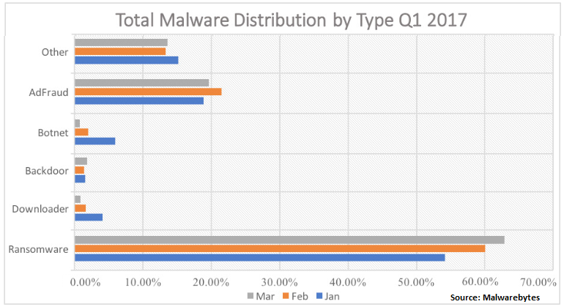
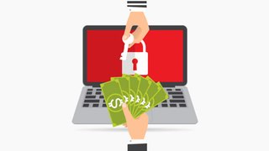
Ransomware
privacy.html
You are denied access to your data/system
Pay… or your data is destroyed
Ransomware has exploded in “popularity”
Open source “kits” for anyone who wants to make some extra money
Ransomware “as a service”
Delivered via phishing email, social media, watering hole, compromised website
Your two options to cope with ransomware:
Never click on ANY link/attachment in any email or webpage
Have offline back-up copies of all data that you value (use a back-up program to automate the process)
Recent Malware “innovation”: crypto currency mining
Future: “Internet of Things” + ransomware = chaos!

Slide 34
Social media must be managed…
privacy.html
Mailing lists – If you post a message to a mailing list… Do you know who else is on that list? Is there an archive of that list’s messages?
Blogs such as Facebook – Assume that your content will be archived and shared with a very large audience
Information you (or your kids) post can assist with identity theft: (birthdate, home town, name of high school, dog’s name, etc)
Are your co-workers also Facebook friends? 8 of your friends have college degrees in “International Relations” and their kids go to Mclean High School…
Facebook Privacy controls are splintered into many different sections and layers. New features are usually defaulted to “everyone”. You have to keep changing them to “friends only”
Facebook tracks you across many websites
Facebook has been “experimenting” on users

Slide 35
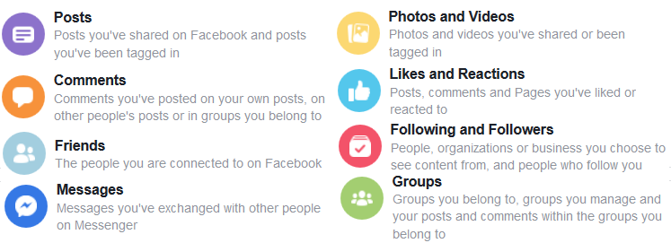

A decade of YOU on Facebook
privacy.html
facebook.com/settings?tab=your_facebook_information
“Download Your Information” → “all of my data”, “HTML”
“Access Your Information” → “expand all”

Slide 36

Download archive of Linkedin connections
privacy.html
linkedin.com/psettings/privacy
“Download Your Data” → “the works”, “Request archive”
Note: Archive comes in two separate downloads

Slide 37

Google, Gmail, YouTube, Android, etc
privacy.html
takeout.google.com
Leave all selected → “next”, choose file size 1GB – 50 GB

Slide 38
Mobile Devices
privacy.html
ALL of the previous topics apply to your cell phone ( persona, IP#, http_referrer, cookies, etc)
AND add: microphone, camera, GPS, Wi-Fi, bluetooth, compass, accelerometer, 3-axis gyroscope, barometer
Installed apps with permission, can establish a detailed pattern of life
Phone can also leak to nearby smart billboards, in store tracking, car bluetooth (rental car bluetooth)
Any company that tracks you, can monetize data about you

Slide 39
Security and Privacy Issues
specific_page.html
Background and Statistics
Network connections ( at work and home )
Firewalls, Anti-Virus
“Persona” details and options
Tracking you cyber: web browser, email, social media
Tracking you physical: phone, internet of things
Critical Advice and Summary
Online web page = http://navigators.com/issues.html

Slide 40





Consider Alternatives
Research “ecosystems” of products ( Microsoft vs. Apple vs. Google )
Alternative products may be more secure, or less targeted by hackers.
Browsers
Email Clients
Operating Systems
Search before you buy: model # security breach

Slide 41

User Agreements... READ THEM!
privacy.html
Read user agreements for everything with Internet access
Samsung Smart TV with Voice recognition:
"Please be aware that if your spoken words include personal or other sensitive information, that information will be among the data captured and transmitted to a third party through your use of Voice Recognition."
How many microphones are in your house? Cell phone, tablet, laptop, flat screen TV, remote control (Roku, Xfinity/Comcast), Alexa, XBOX, Barbie doll, baby monitor, security camera, NEST thermostat

Slide 42


If it connects to the Internet, it must be updated
update.html
All Programs → Windows Update
Network devices – modem (yours or ISP’s)
Router updates. Printer, network attached storage.
Laptops: Windows 10, 11 Mac OS
Microsoft Office
Browser (Firefox, Chrome) plug-ins, Java, Flash, PDF Acrobat
Other software: security suite, skype
Tablet / Cell phone : Android, Apple IOS, apps
“Internet of Things” - Xbox, Wii, playstation, DVR , Roku, Smart TV, blu-ray/dvd player, stereo, alarm system, fitness devices, cameras, smart watch, home automation – thermostat, switches, refrig, car, kid’s toys

Slide 43

Password Chaos
password.html
Current plan: A handful of simple passwords persistently re-used on 30+ accounts!
Complex password = 12+ LeTtErS, numbers, characters
If writing it down, portions of password should be camouflaged
Example: Go = Go out and play in the back yard = Goapitby Write: Go98(* → type: Goapitby98(* Its = It’s the end of the world as we know it = Iteotwawki
30 accounts need 30 different passwords (sounds complicated)
Customize your password for each account
Example: Amazon begins with “Am”, Netflix begins with “Ne” Write: Amazon = GoAm98(* → type: GoapitbyAm98(* Write: Netflix = GoNe98(* → type: GoapitbyNe98(* Write: Citibank = ItsCi3# → type: IteotwawkiCi3#

Slide 44


Resetting Your Password
privacy.html
Hacker can’t guess your password… They click on “forgot password”
At the target website:
Password hints… based on public information?
Extra questions to verify identity … Also based on public information?
Via email reset..
Send password reset link to your email
Hacker breaks into your email… they can discover all other accounts that send you email (banking, shopping, etc)
Your email account = keys to how many other accounts?
Two factor authentication? – “something you know” + “something you have”
A confirmation text or reset code sent to your cell phone:
Your cell phone = keys to how many other accounts?
Your email and cell phone = gateway to ALL your other accounts

Slide 45
Beware of Infrastructure in Public Places
privacy.html
Public Computers in Library, Hotel Lobby, etc
Is there any kind of consistent “administration” to guarantee the integrity of these computers?
For a public computer, always assume that the machine has been compromised, and that a “keystroke logger” is quietly capturing all keystrokes
Public Wi-Fi (hotel, Starbucks, etc) – packet sniffer can capture all traffic
Ignore all software update notices while on public Wi-Fi
Use a VPN Service
USB charger port at airport / hotel – Use your own USB adapter and plug directly into electrical outlet
Never use a free or “found” thumbdrive

Slide 46






Consider Offline Storage
privacy.html
$400+ : A second PC without a network connection. You can use a KVM switch to run this PC to your existing keyboard/monitor
Where will you store the offline media?
$350 : an extra notebook computer
~$100 : Second hard disk – can be external,
or internal with a lock key to switch disks
Removable media – optical or magnetic storage
USB flash drive – some include encryption

Slide 47


Local Set-up options
privacy.html
Consider using encryption at home to protect personal data . For example, encrypted file systems are now standard in Windows.
Some applications offer encryption schemes for files (quicken), but these are not very secure. There are numerous “cracker” programs which will easily break these open.
Require passwords for access to computers or internet access
Create multiple user accounts (even for yourself)
Physical security of computer

Slide 48
Worst case considerations
Look at the content of your hard drive - what if a clever website were able to copy your files?
What if ransomware were to lock-up/destroy your files?
If your research requires you to visit “exotic places” you should use a “sacrificial machine” - which has a very “bland identity”
On the “sacrificial machine”, never use personalized sites (Gmail, amazon, local restaurant, etc)

Slide 49



Future
privacy.html
Biometric scanner – finger, face recognition, voice, eye
Other devices leaking information –cell phone/ Car, IOT
Much personal Information is in databases: phone number, map, county taxes, DMV, court records, supermarket purchases, credit card company, phone company records, etc.
Proposed law would give copyright owners the right to hack your PC
Patent filed by Verizon to use microphone and cameras in your house to customize ads sent to your TV/phone/tablet
Fingerprint scanner as USB accessory or built into a notebook

Slide 50
Exercise: Count your digital connections…

Slide 51


The Matrix has you!
Advertisers are some of the best technical targeters out there because they can see: - what a person is doing, - where they are doing it, - how effective their work has been to date!
See how deep the rabbit-hole goes

Slide 52

You as a targeter !
privacy.html
Advertisers are focused on YOU!
Adversary Targeter focused on YOU?
Many targeting concepts can be illustrated by understanding the personal digital environment ( selectors, devices, network )
Learn how much user data is collected, leaked / shared / sold by default
If someone has implemented many of these tips, does that indicate they have security/OPSEC training?
- https://www.socom.mil/Documents/SOCOMSmartcards.pdf - odni.gov/files/NCSC/documents/campaign/DoD_IAPM_Guide_March_2021.pdf - www.pa.gov/content/dam/copapwp-pagov/en/pccd/documents/victim-services/ documents/2023-stop-conference/digital_exhaust_guide-law_enforcement_partners_version_2.0_final.pdf
Notes:
​
​

Slide 53

Location details (EXIF) in your photos
privacy.html
---> Additional Details in IAPM Guide: Pages 25-28

Slide 54
Final Advice
advice.html
Always be self-aware of your persona
Know what policies apply to you
Go HOME – make backups (just in case)
Update all software from modem → smart watch
Download a copy of: “your Facebook data”, “what Google knows about you”, “Linkedin profile”
Email & social media = THE attack path to you!!
Confirm the sender before you click on anything

Slide 55

Summary
ALL Internet accounts make footprints
Online companies are finding new ways to monetize YOU
A determined attacker can take the time to research YOU, and create the “perfect” PHISH bait
Ensure ALL Internet users know the best tradecraft techniques to minimize devastating leaks to targets / public
Master the Information Superhighway
or
Become Roadkill
Ouch, I should have used OPSEC & Tradecraft

